Slide 1

“INTELLIGENT HEALTH MONITORING SYSTEM”
DEPARTMENT OF INFORMATION TECHNOLOGY
GUDLAVALLERU ENGINEERING COLLEGE
UNDER THE GUIDENCE OF
DR.M.V.L.N RAJA RAO
(HOD & PROFESSOR)
PRESENTED BY
B.YASHASWINI(13481A1205)
B.SANDHYA(13481A1206)
D.RAKESH(13481A1211)

Slide 2
CONTENTS
ABSTRACT
EXISTING SYSTEM
DISADVANTAGES
PROPOSED SYSTEM
ADVANTAGES
SOFTWARE REQUIREMENTS
HARDWARE REQUIREMENTS
MODULES
UML DIAGRAMS
CONCLUSION

Slide 3
ABSTRACT
This project helps us in discovering our own health status with the help of physical body measurements.
The goal is to provide some basic tips and health standards with user entry data.
In this website we can evaluate our own diet and can see the results online.
This website also provides the guidelines for good diet habits to be followed daily and also the preventive measures to be adopted to avoid health problems.
The information is also provided in their native language.

Slide 4
EXISTING SYSTEM
The existing medical websites provide information on various areas of health in jorgen language.
For example if we take nutritiondata.self.com website which is based on health ,
In this website we can calculate our calories burned ..so on .
They display the nutrition chart needed for a person and by seeing them it is difficult to calculate the calories of our diet.
All the existing systems provide information in a generalized form.

Slide 5
DISADVANTAGES
A user may not have any idea of nutrition chart measures .
User may be naïve on medical grounds.
Doesn’t have any idea on the availability of nutrients in food resources.
May not know the proper food item names or pictures.

Slide 6
PROPOSED SYSTEM
In this intelligent health monitoring system , a person can himself take
a virtual physical health checkups on their body .
It also gives the right nutrition charts for right ages. It also alerts us on
our future health problems.
We can calculate our calories based on our food we take daily.
Provides primary first aid for injuries like snake byte.
It suggests the type of doctor to be consulted.

Slide 7
ADVANTAGES
Free online health checkups.
Online results on our health.
Warnings and suggestions on our future health problems.
Our daily calorie intake visualization.

Slide 8
SOFTWARE REQUIREMENTS
Front end :
HTML
CSS
Java Scripts
Angular.js
Webbrowser
Back end:
PHP
Microsoft excel
chart.js (Data visualization)
WAMPP(MySQL,Apache)

Slide 9
HARDWARE REQUIREMENTS
4GB RAM.
Network connection.
1TB HDD.

Slide 10
Modules
Visitor
1.List of nine calculators are provided. They are BMR,BMI,ABW,IBW,Calorie intake,Bodyfat%,
Calories burned,BSA,WHtR,WHR.
2.Along with those calculators information is provided.
3.Vistor can calculate and if he want more benefits he should singup.
Customer
1.A customer must login through visitor page.
2. A guidence is provided.
3.Self check calculator and test results are provided.
4.Customer can check his daily intake with the help of diet calculation.
5.He can translate it inany language.

Slide 11
VisitorModule
BMI
Body mass index (BMI) is a measure of body fat based on your weight in relation to your height, and applies to most adult men and women aged between 18 to 65.
BMI=weight in kg/(height in meter)2
BMR
The amount of energy (in the form of calories) that the body needs to function while resting for 24 hours is known as the basal metabolic rate, or BMR.
Men BMR=879+10.2(weight in kg)
Women BMR=795+7.2(weight in kg)

Slide 12
Visitor Module
Calorie intake calculator
To accurately determine your daily calorie intake amount above based on your BMI.
Conditions:
1)Sedentary BMR*1.2
2)Lightly Active BMR*1.3to1.4
3)Moderately Active BMR*1.5to1.6
4)Very Active BMR*1.7to1.8
5)Extremely Active BMR*1.9to2.2

Slide 13
VisitorModule
IBW
Your ideal body weight based on your height.
For male : IBW=50kg+2.3kg for each inch over 5feet
For women : IBW= 4.55kg+2.3kg for each inch over 5feet
ABW
If the actual body weight is greater than 30% of the calculated IBW then calculate
your adjusted body weight.
ABW=IBW+0.4(actualweight-1BW)

Slide 14
Visitor Module
WHR
A person's waist-to-height ratio (WHR), also called waist-to-stature ratio (WSR), is defined as their WHR circumference divided by their height, both measured in the same units.
WHR=weight in inches/height in inches*100
BSA
Total surface area of the human body. The body surface area is used in many measurements in medicine, including the calculation of drug dosages and the amount of fluids to be administered
BSA(m2)=(height(cm)*weight(kg)/3600)^1/2

Slide 15
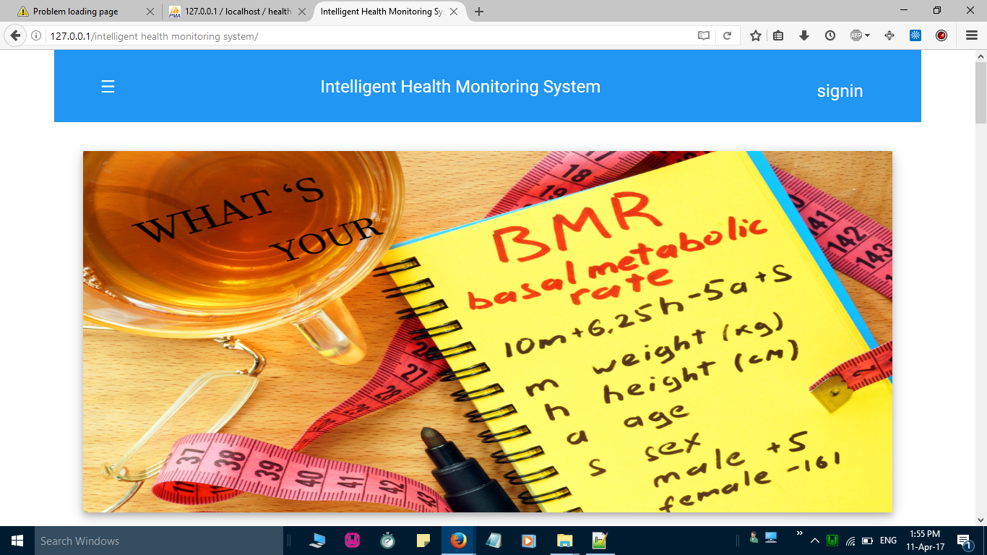
Screen Shots of Visitor Module

Slide 16
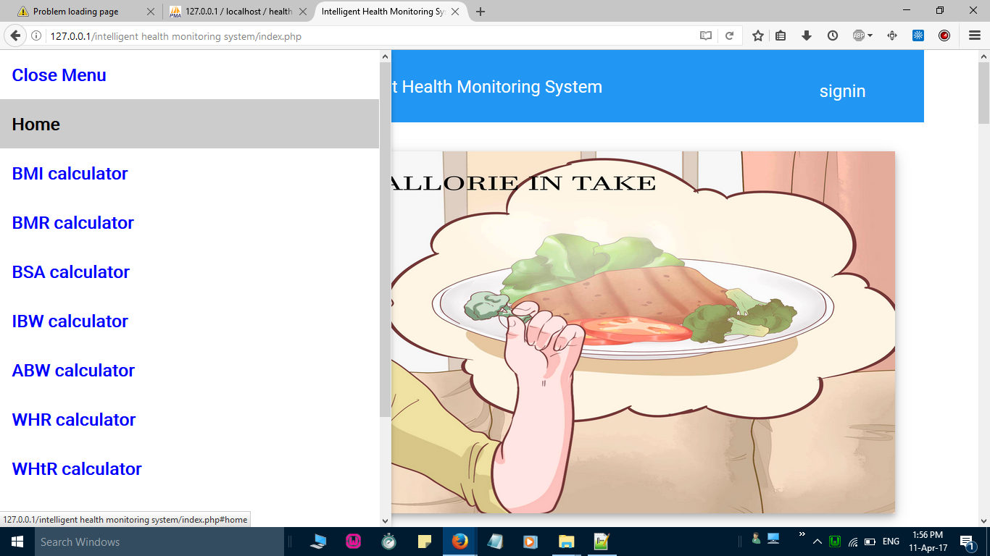

Slide 17
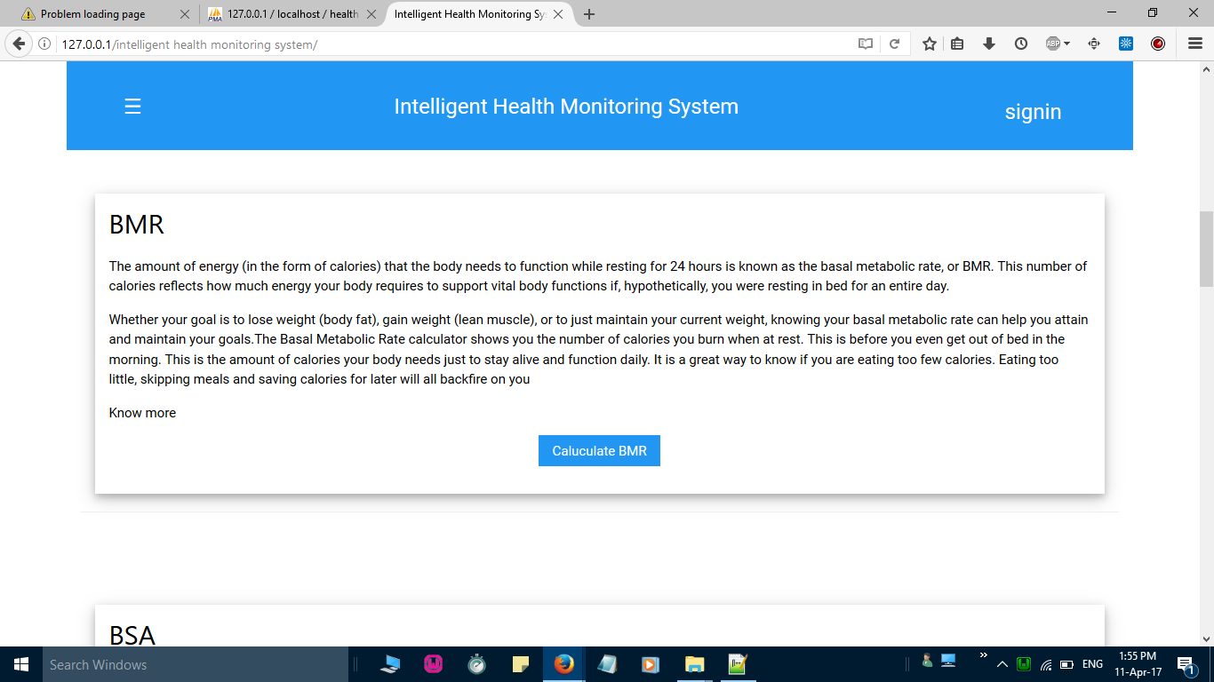

Slide 18
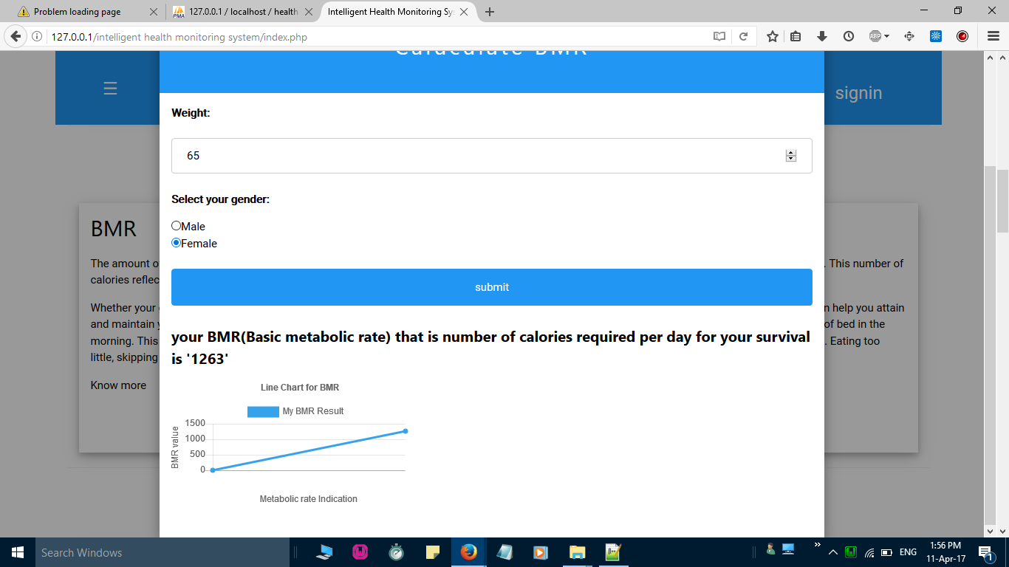

Slide 19
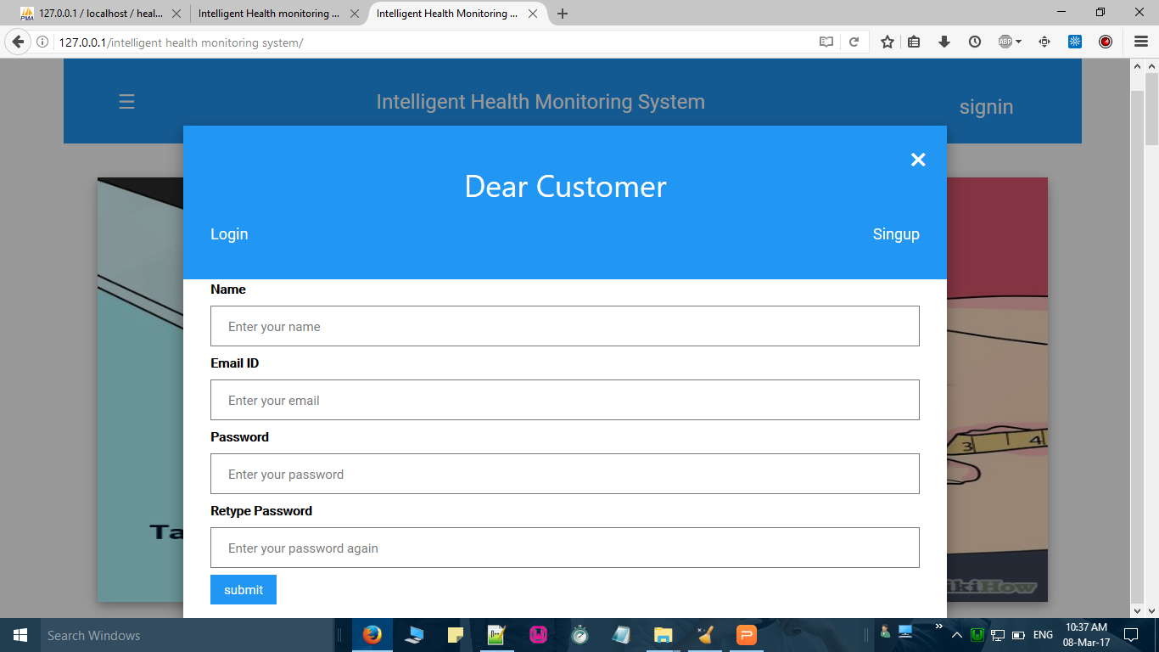

Slide 20
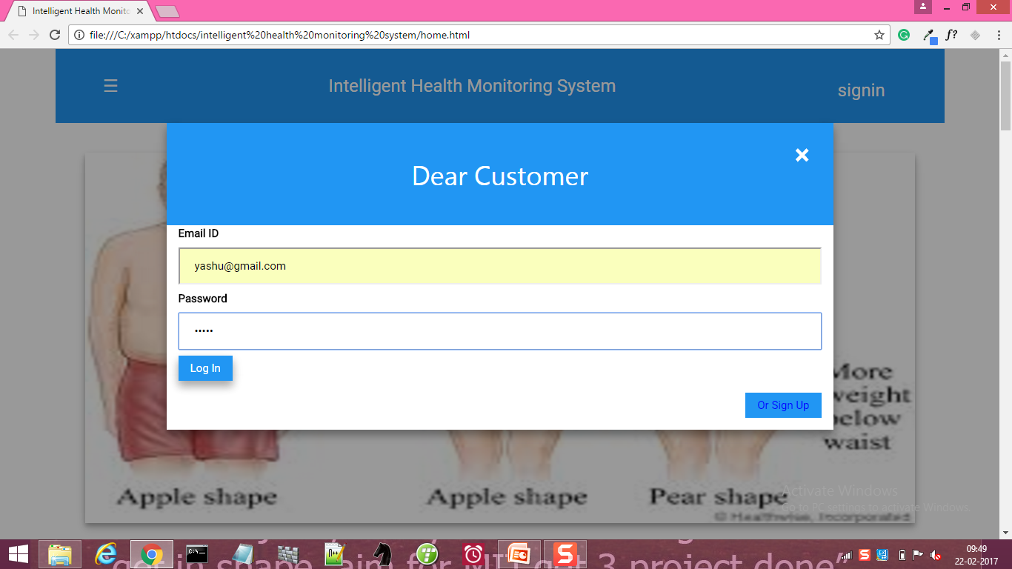
Customer Module

Slide 21
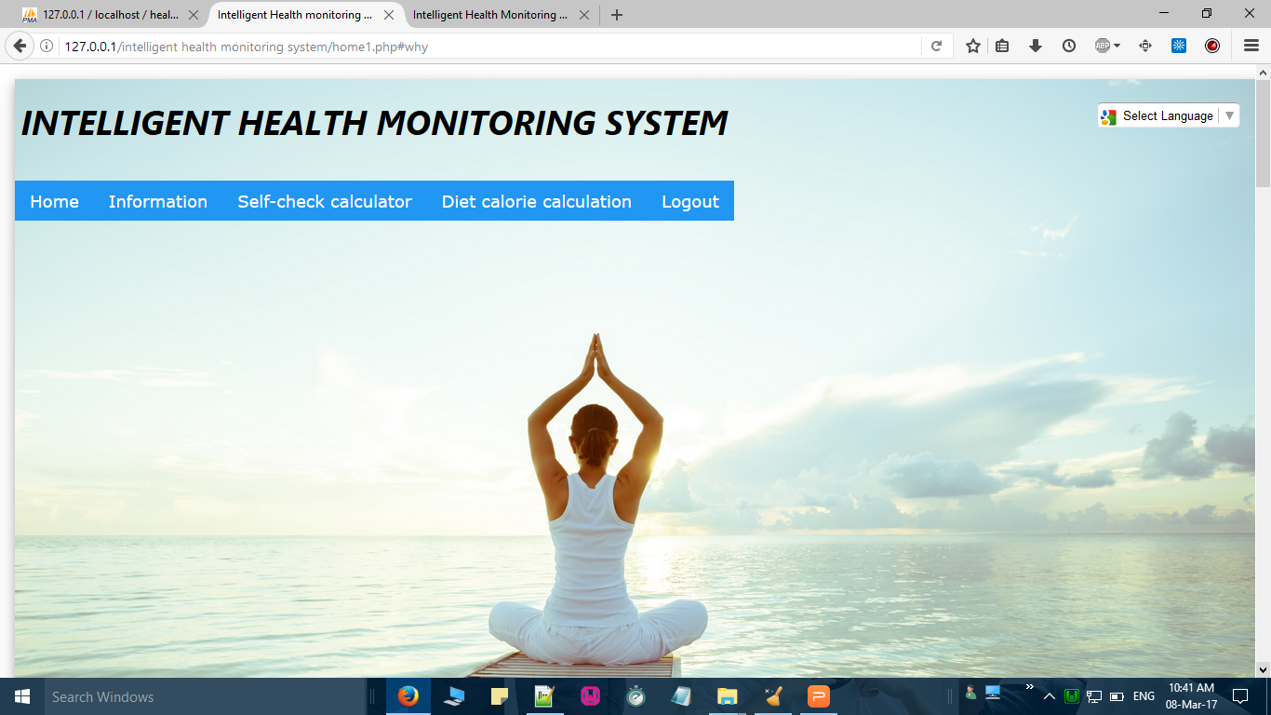

Slide 22
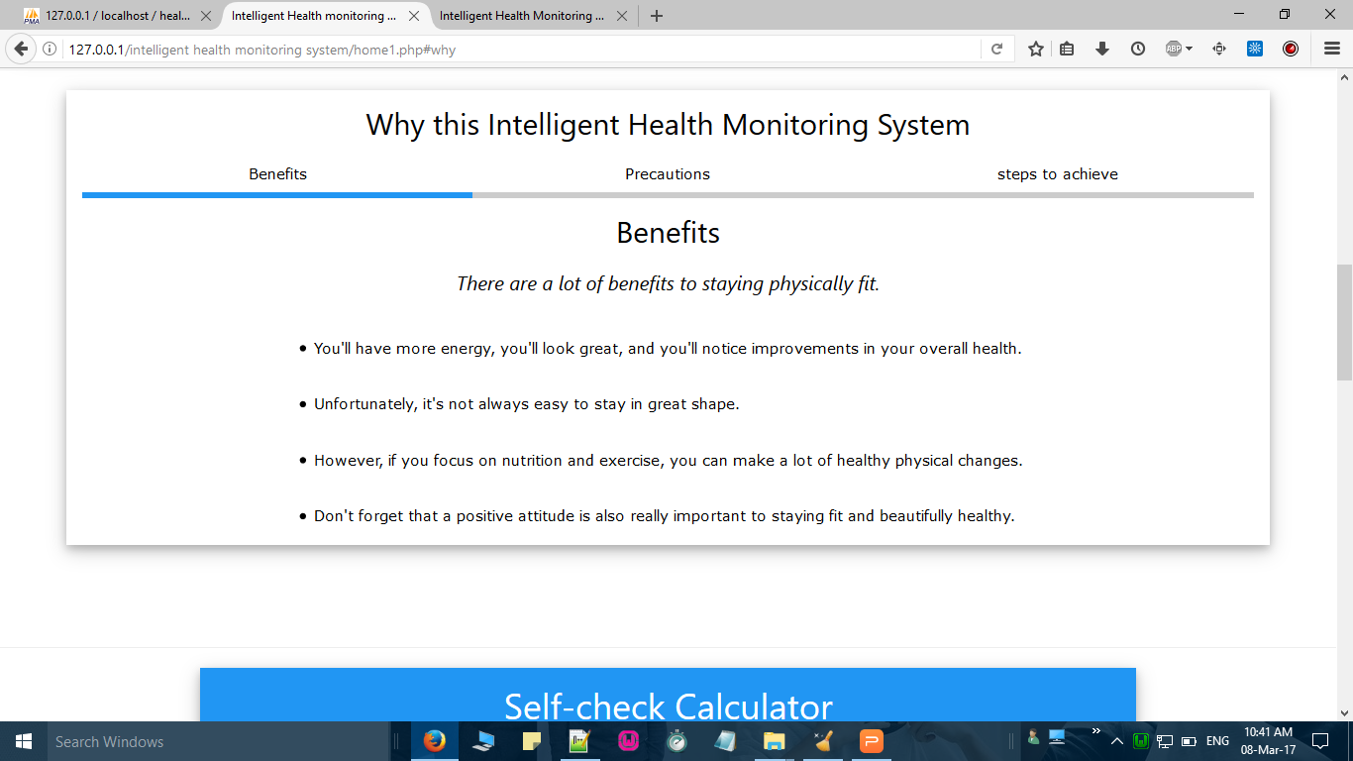

Slide 23
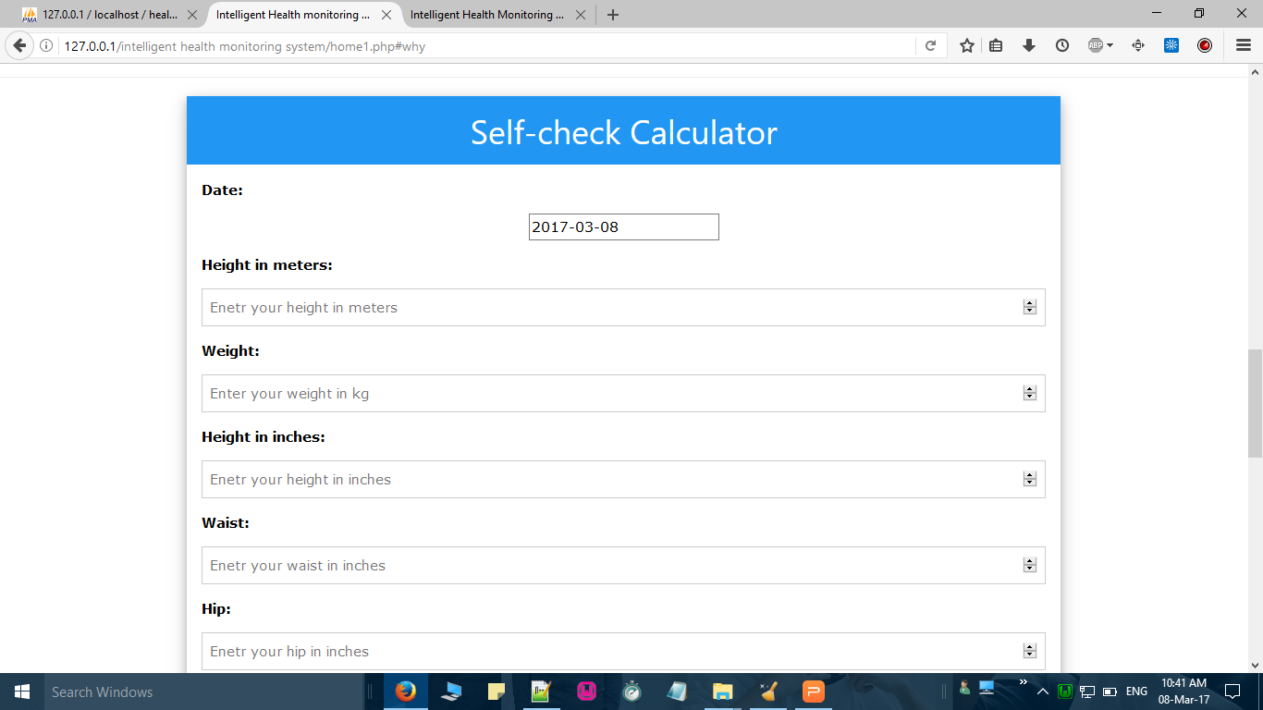

Slide 24
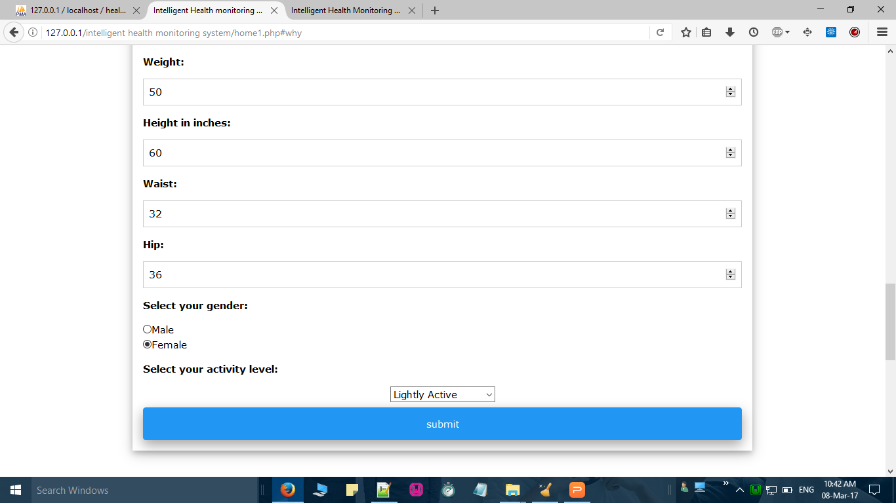

Slide 25
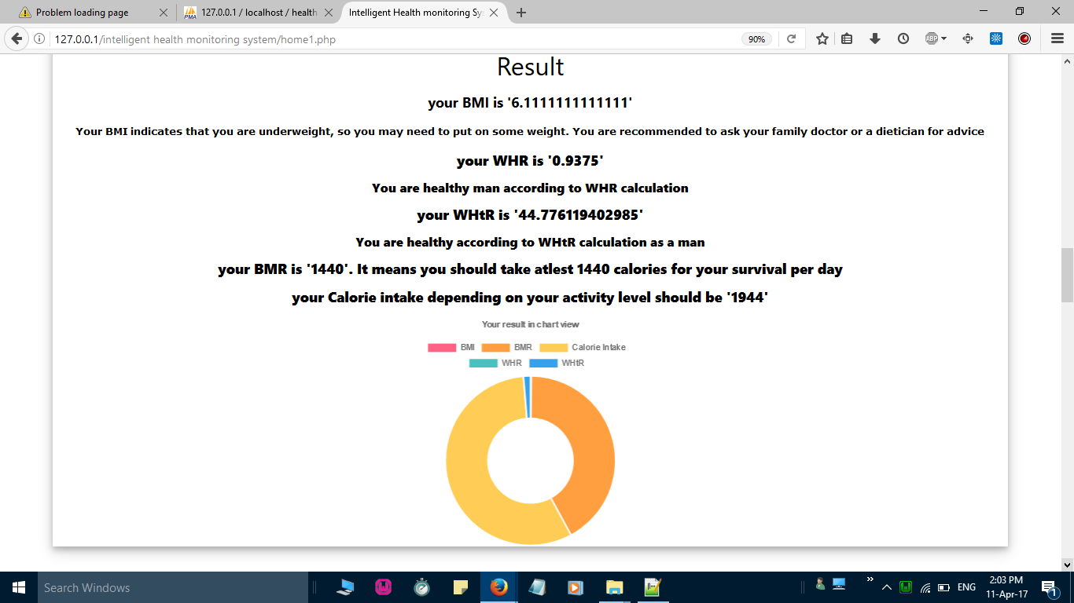

Slide 26
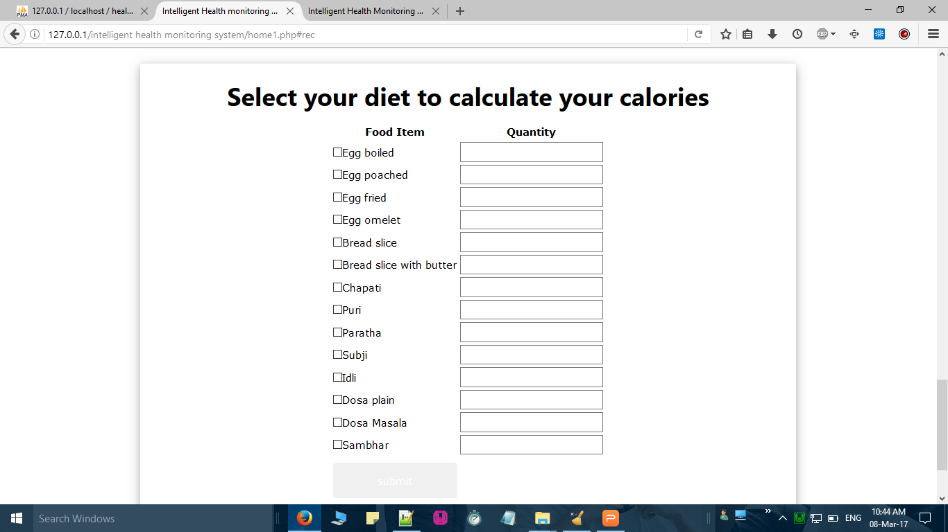

Slide 27
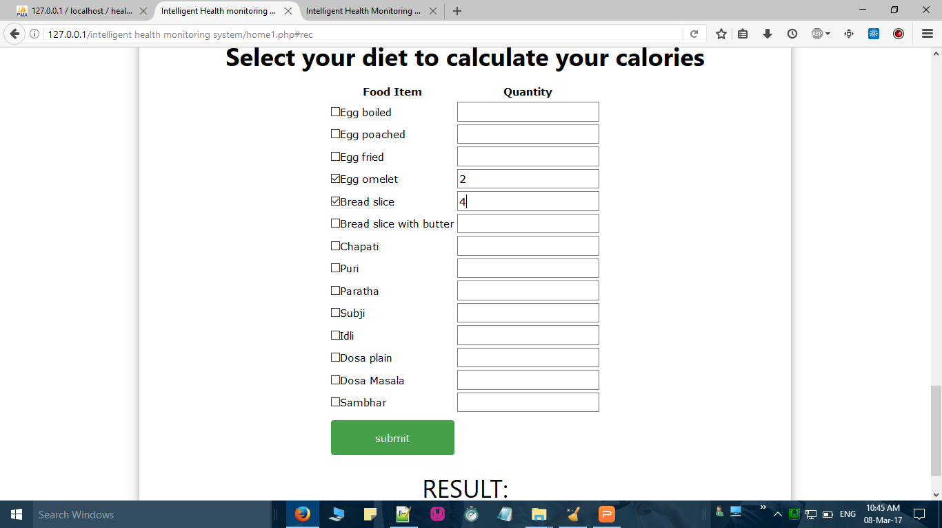

Slide 28
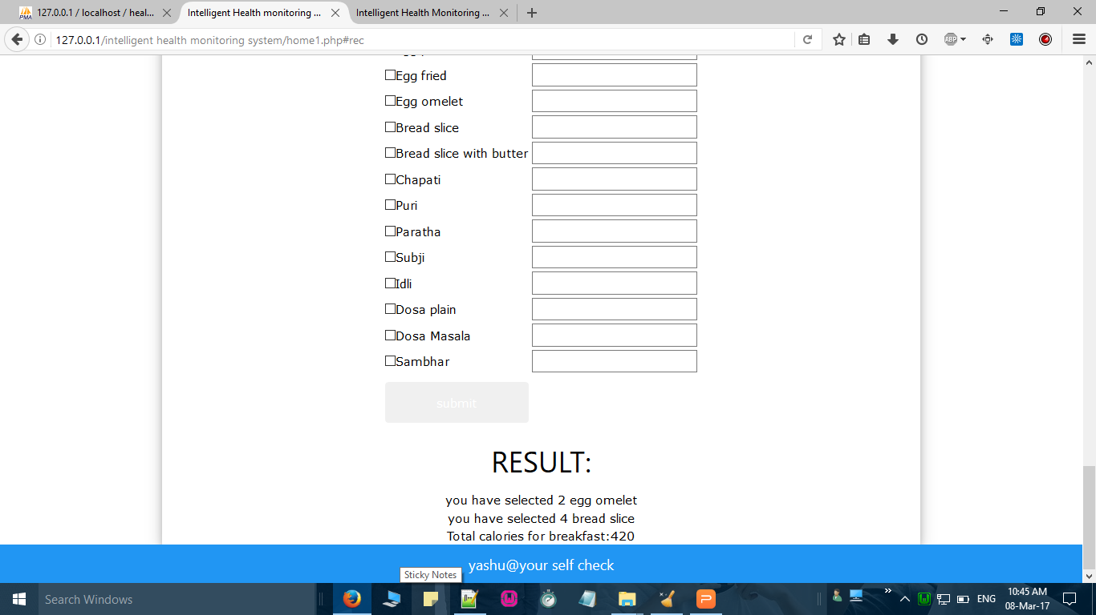

Slide 29
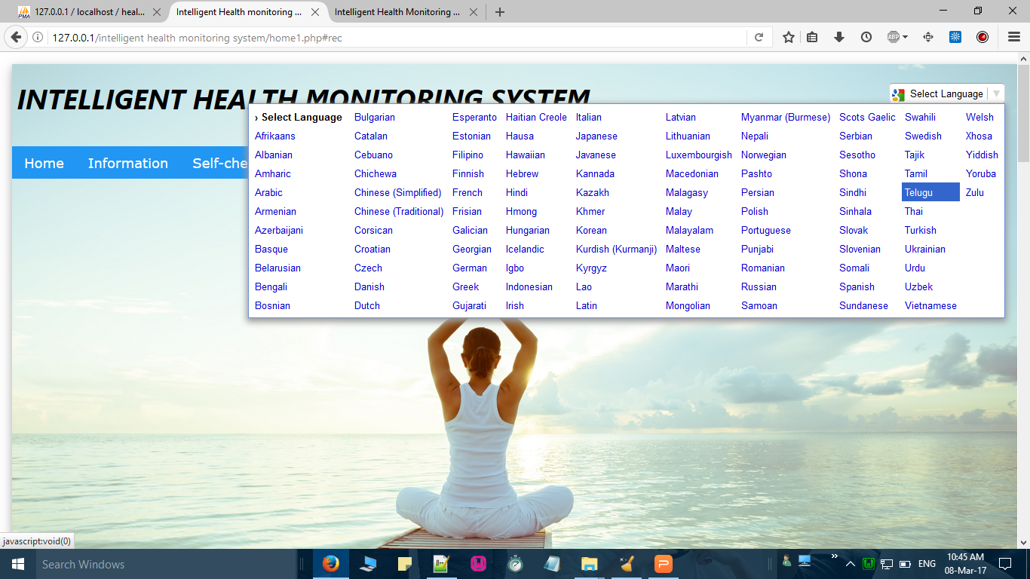

Slide 30
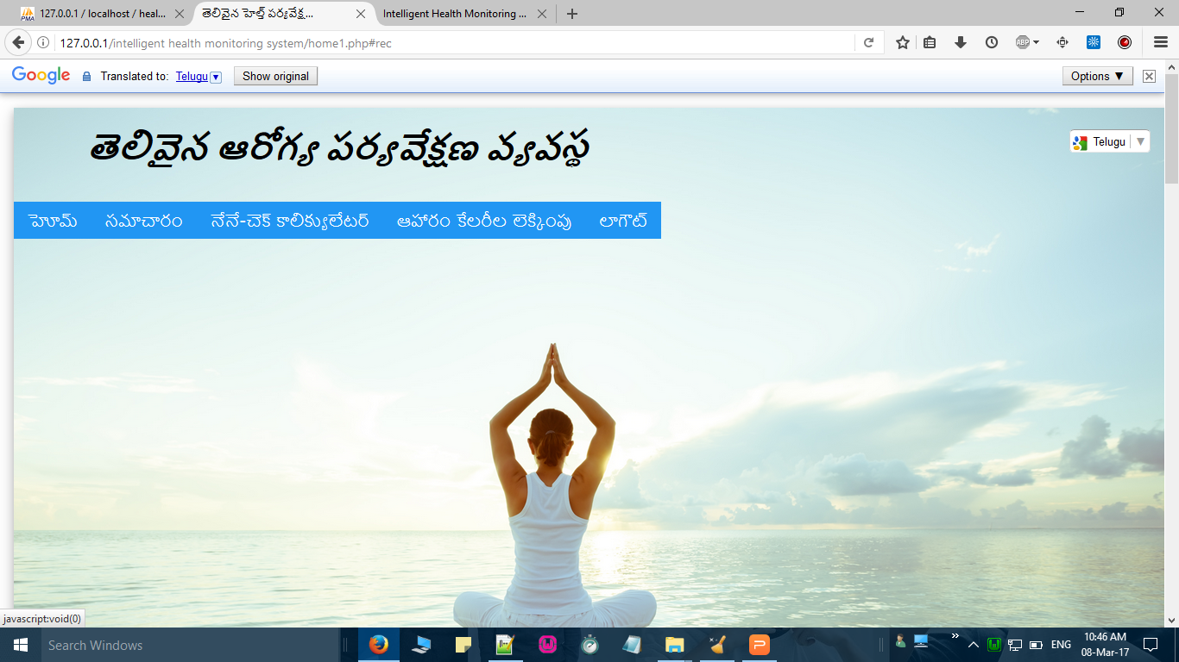

Slide 31
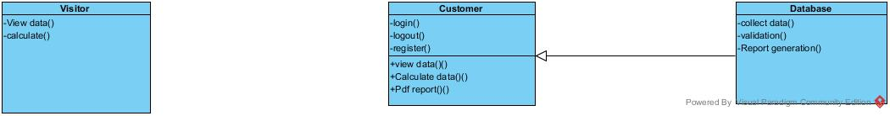
UML diagrams
Class diagram

Slide 32
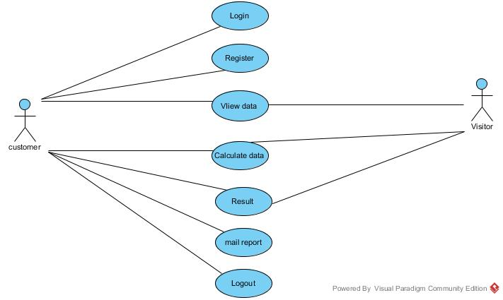
Use case diagram

Slide 33
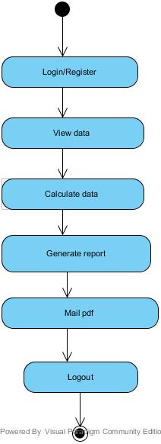
Activity diagram

Slide 34
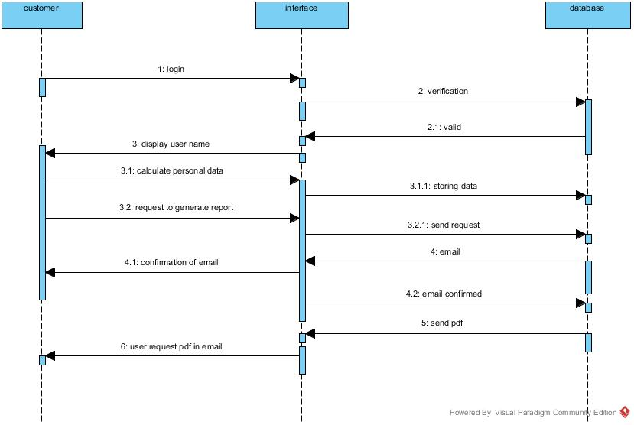
Sequential Diagram

Slide 35
Conclusion
This website provides sample diet suggestion.
It consults the type of doctor to be suggested.
It gives primary first aid guidence to injuries.

Slide 36
ANY QUERIES???
THANK YOU.

